Slide 1


Slide 2

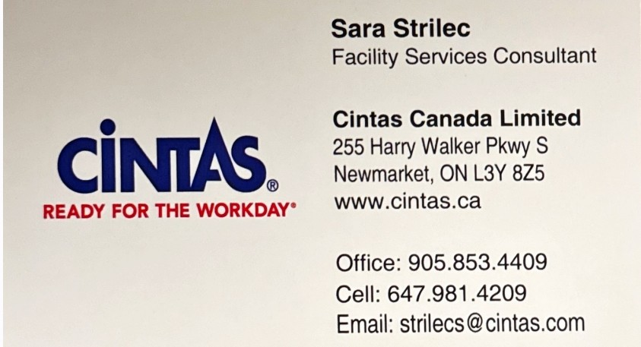
Facility Service Sales Representative – Sara Strilec
L7B – King City/Nobleton
L0G – Schomberg
L0N, L7K, L7C – Caledon
L7E – Bolton
L9R – Alliston
L9W - Orangeville
My Territories:

Slide 3









A culture leading to success
The Cintas culture brings together our employee-partners. They know every job is critical, that teamwork promotes excellence, collaboration drives innovation and training gets them Ready for the Workday®.
5
₁₂ distribution
centers
manufacturing facilities
1,000,000+
We ended fiscal 2020 with record revenues of
7.08 billion
450+
customers
locations
40,000+
14,500+
employee-partners
trucks in operation
Notes:
3 biggest fleet in north America, we cn reah 93 % of north Americas territory

Slide 4
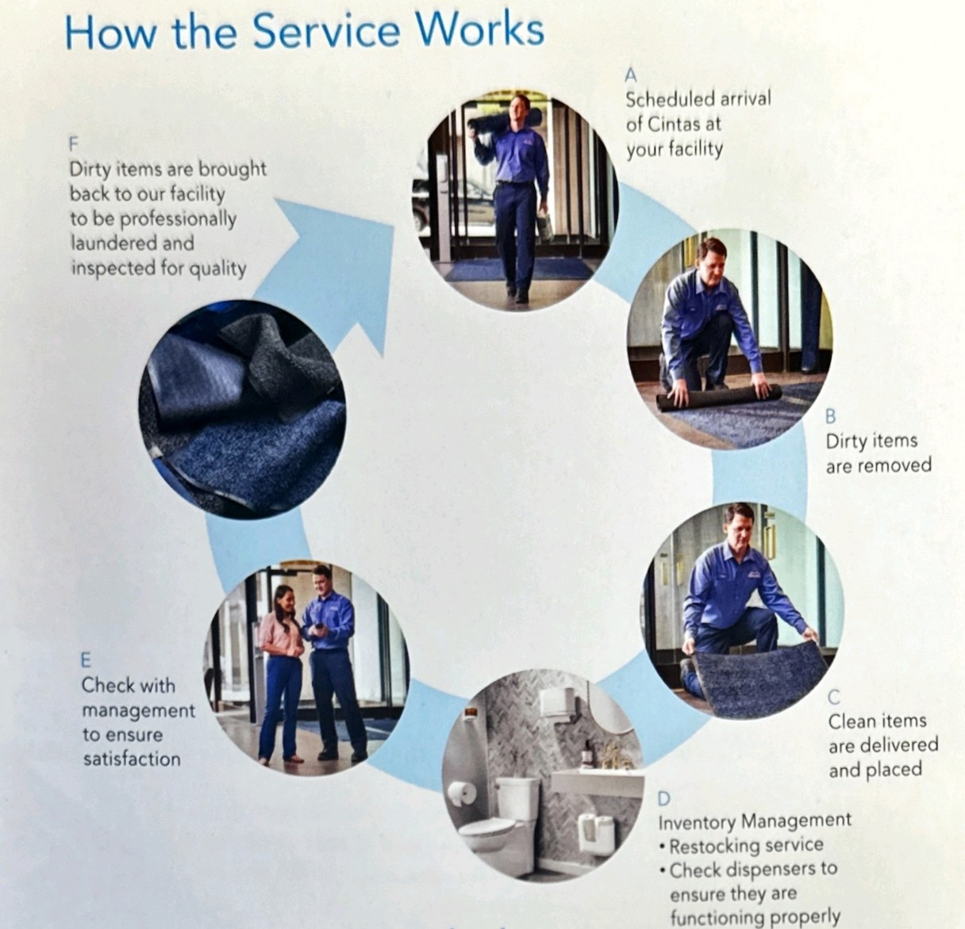
HOW THE PROGRAM WORKS

Slide 5
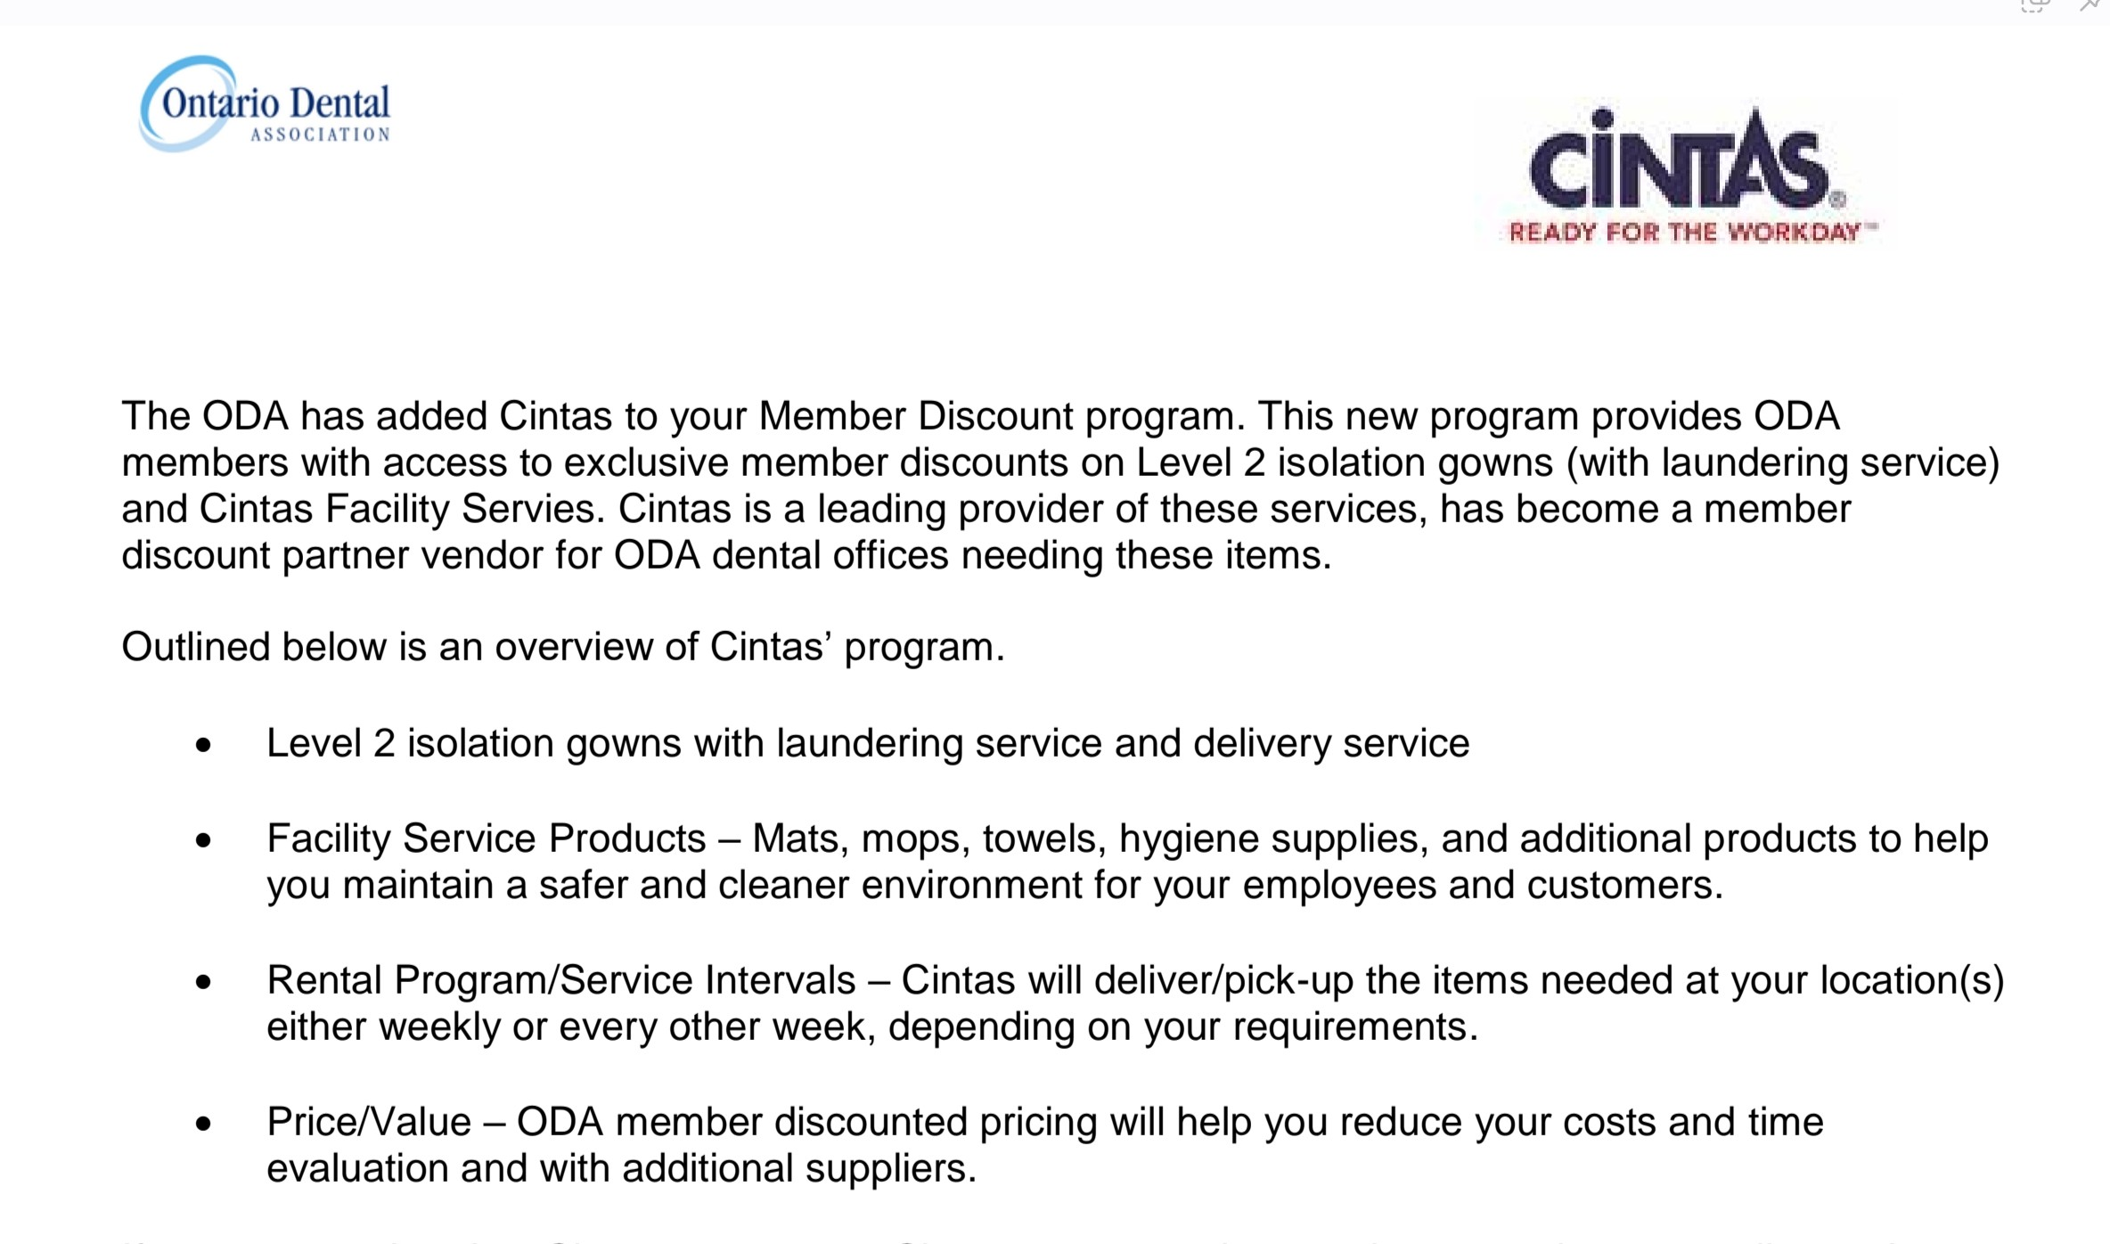
CINTAS ONTARIO DENTAL ASSOCIATION PARTNERSHIP

Slide 6
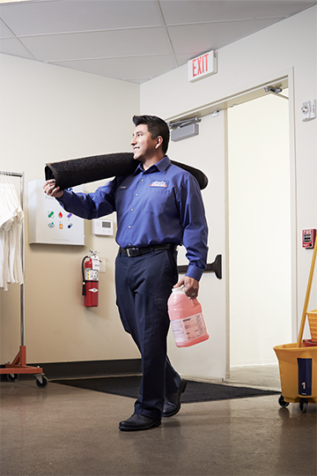
Be confident and ready™ to open your doors
99.9%
Of microbes are removed with our Microfiber and just water
All Cintas mats are certified high traction by the National Floor Safety Institute (NFSI)
A typical business can save 20+ hours per week using our facility services program
30%
Compared to manual mixing with properly diluted cleaning chemical system
SAVINGS
Restroom
Supplies
Cleaning
Chemicals
Restroom
Cleaning
Mat
Services
Mop
Services
Facility Services Solutions
Get ready™ from top to bottom with the Clean Zone program. Cintas offers a variety of solutions to help improve your image and protect your business.
Tile & Carpet
Cleaning
Towel
Services
Parts
Cleaner
Micro Fiber
Cleaning System

Slide 7
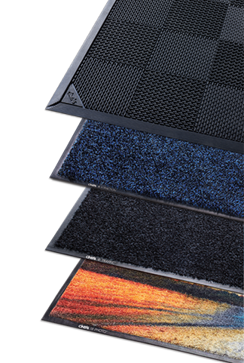

The key to a clean facility is right under your feet
A welcoming entrance and clean, dry floors are important to your customers and visitors. No other rental mat can compare to the performance and quality of Cintas High Performance Series™ mats
CAPTURES 3X MORE DIRT and DEBRIS
10X the surface area
Captures more dirt and water
Highest traction rating*
ever recorded by nfsi
*From the National Floor Safety Institute; rating for transitional coefficient of friction (TCOF
50% more resolution
Enhances vibrancy and clarity
One square yard of commercial carpeting captures one pound of dirt per week, which can cost as much as $600 to remove, according to ISSA’s 447 Cleaning Times.

Slide 8
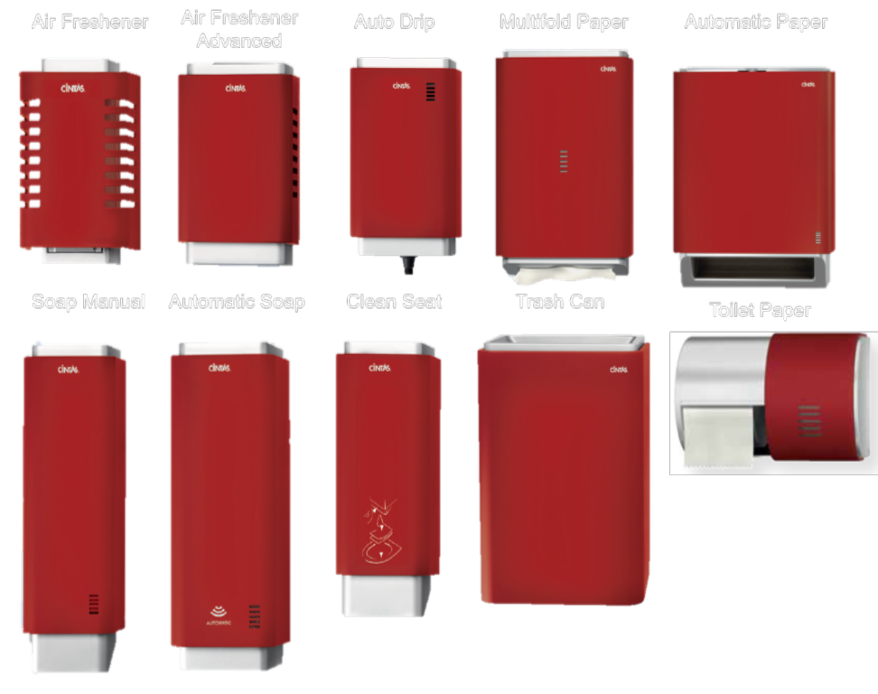
SIGNATURE SERIES RESTROOM SOLUTIONS
these colors available
stainless

Slide 9
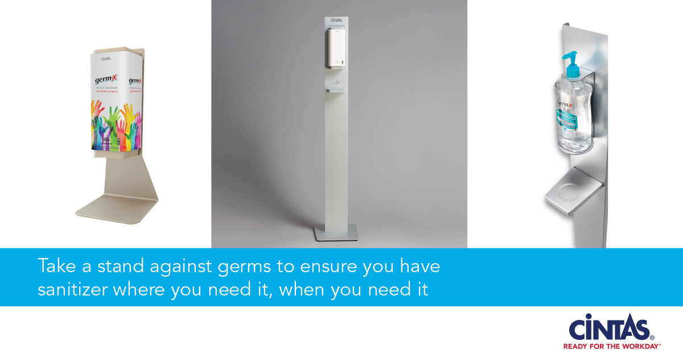

Slide 10
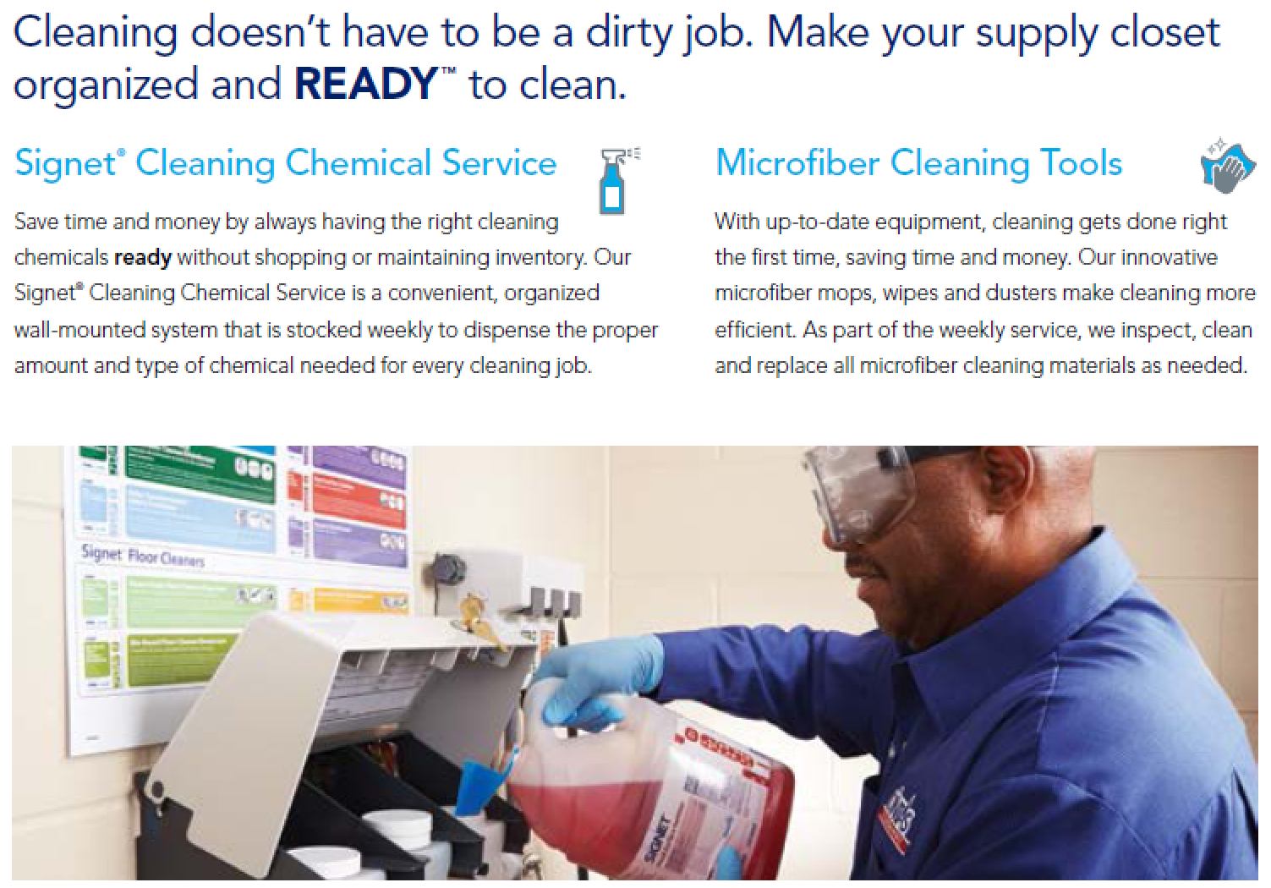
SUPPLY CLOSET

Slide 11
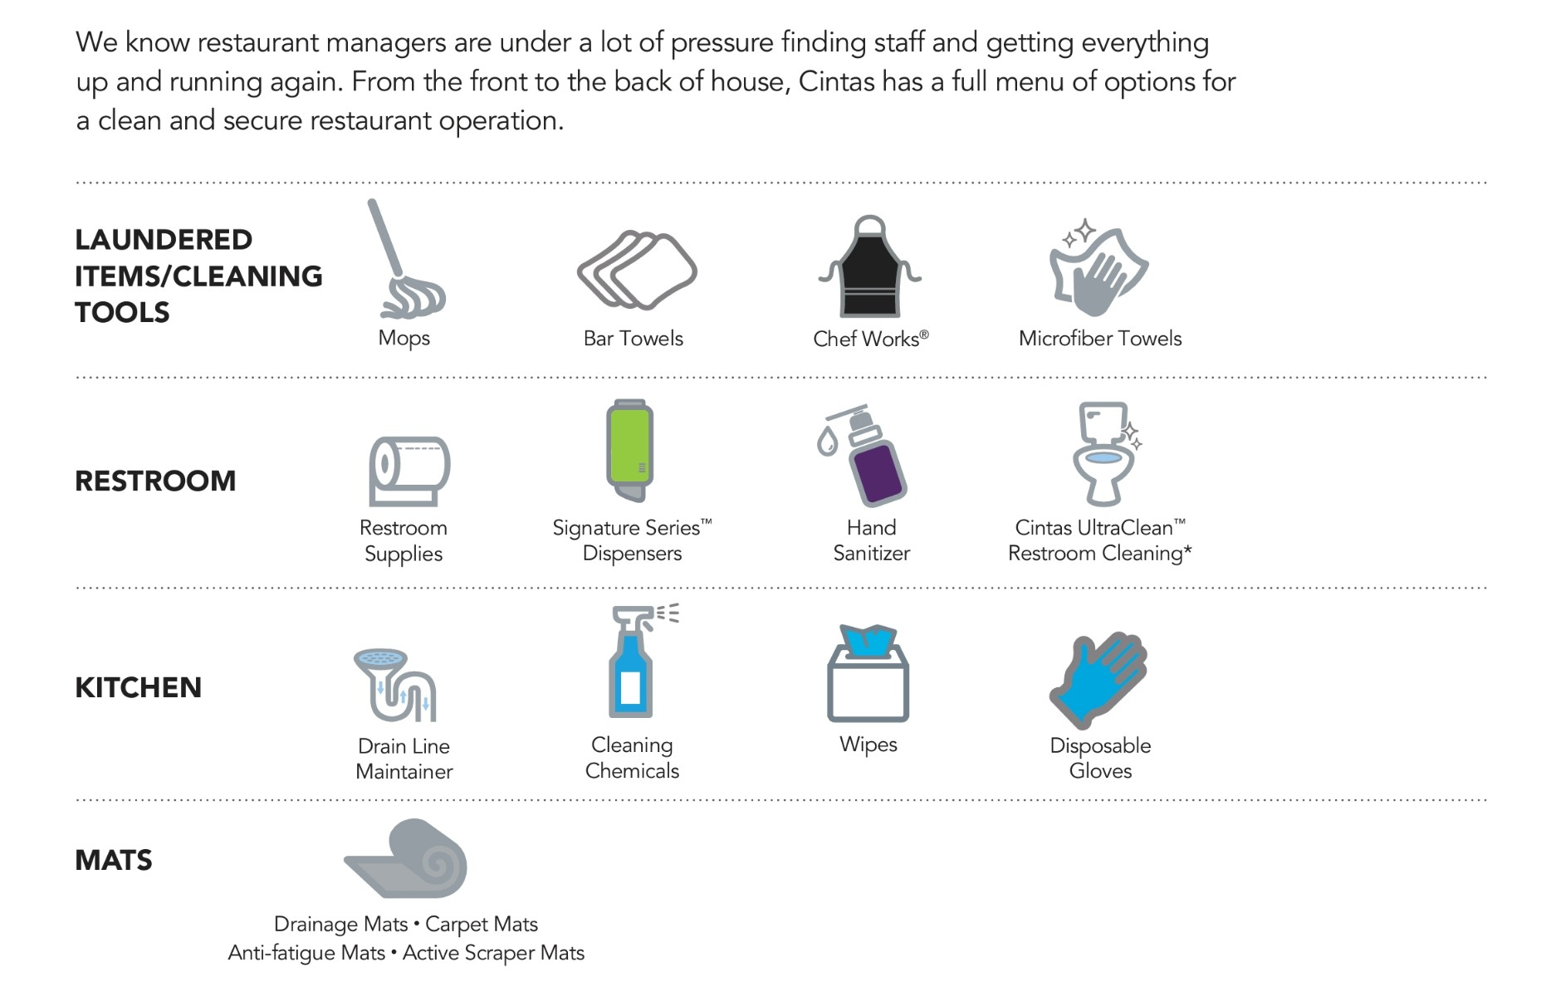
CINTAS RESTAURANT MANAGEMENT

